Slide 1
AWS Step Functions for Microservice Orchestration
A Proposed Pattern for Organizational Use

Slide 2
Agenda
Overview of AWS Step Functions
Use Case: Microservice Orchestration
POC Details
Start Step: Triggering a Lambda
Lambda to trigger ECS Task
Monitoring the ECS Task
Final Step: Lambda Execution
Benefits of Adopting AWS Step Functions
Proposed Architecture
Demo/Results
Next Steps

Slide 3
What are AWS Step Functions
Definition: AWS Step Functions is a serverless orchestration service that coordinates multiple AWS services into scalable workflows.
Key Features:
Visual workflow designer
Built-in error handling and retries
Easy integration with AWS services
Ideal Use Cases:
Microservice orchestration
Data processing pipelines
Event-driven workflows

Slide 4
UC: Microservice Orchestration with AWS Step Functions
Business Need: Orchestrate multiple ECS tasks triggered dynamically by a Lambda function and ensure task completion before proceeding.
Process Overview:
Trigger a Lambda function to initiate ECS tasks.
Monitor the status of ECS tasks.
Execute a final Lambda function upon successful task completion.
Key POC Steps
Trigger ECS Tasks:
Lambda function reads input parameters from S3 or JSON input.
Launches ECS tasks dynamically based on the input.
Monitor ECS Tasks:
Step Function Map state to track task status.
Checks LastStatus and ExitCode to confirm success.
Final Lambda Execution:
Called only if all ECS tasks succeed.
Handles post-processing or business logic.

Slide 5
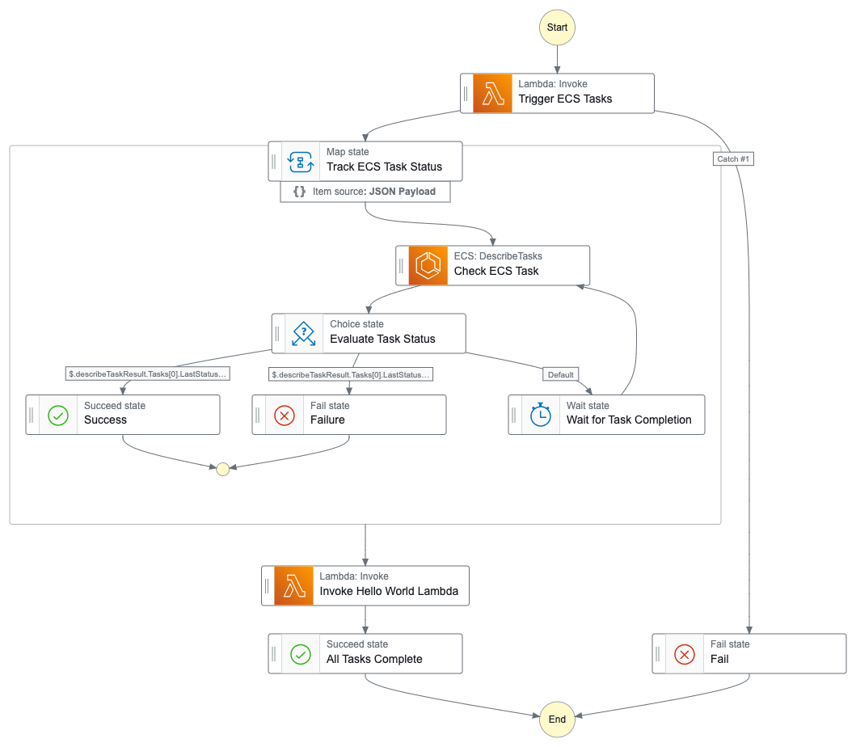
POC Workflow Diagram

Slide 6
POC Result
POC Success:
Successfully triggered and monitored multiple ECS tasks.
Integrated Lambda functions for task initiation and finalization.
Key Metrics:
Task Completion Time
Error Handling Coverage

Slide 7
Benefits of AWS Step Functions
Improved Visibility: Visual workflow with built-in tracking.
Scalability: Seamlessly scales with workloads.
Error Handling: Automatic retries and failure paths.
Integration: Direct integration with AWS Lambda, ECS, and other services.
Cost-Efficiency: Pay-per-use model without infrastructure overhead.
Proposed Pattern for Microservice Orchestration
Pattern Overview: Reusable Step Functions pattern for similar workflows.
Standardization: Provides a consistent orchestration mechanism across teams.
Next Steps: Extend this POC to more complex workflows.

Slide 8
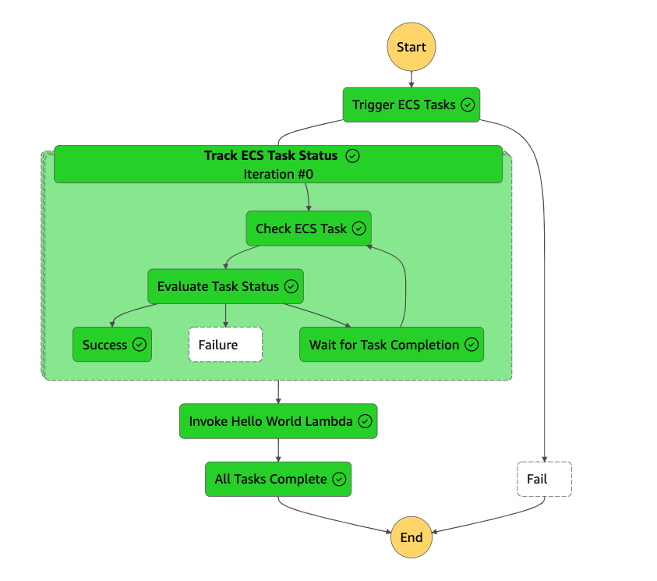
Screenshots

Slide 9
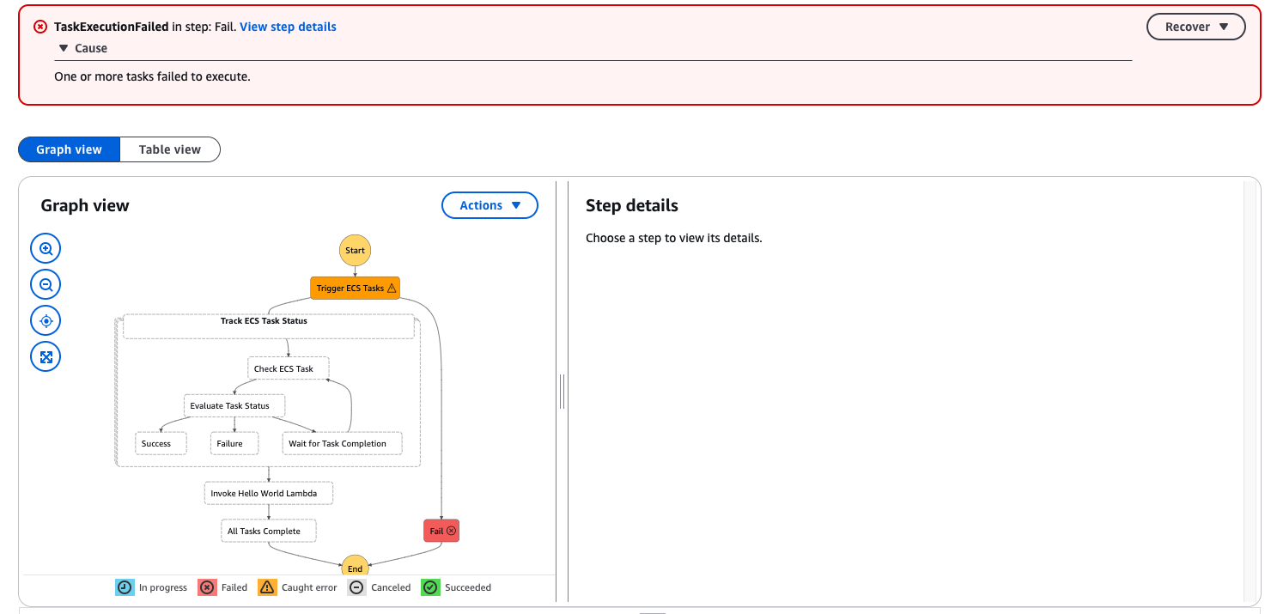

Slide 10
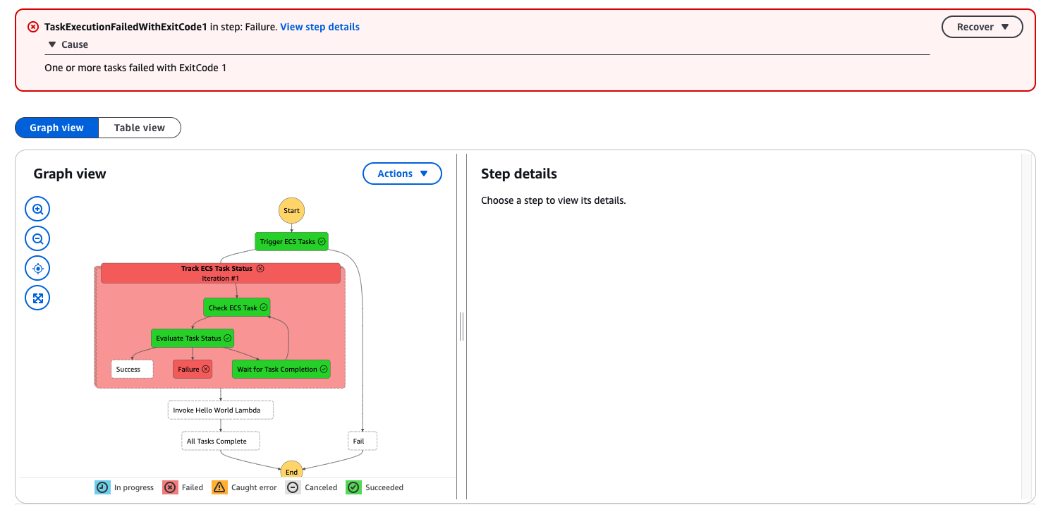

Slide 11
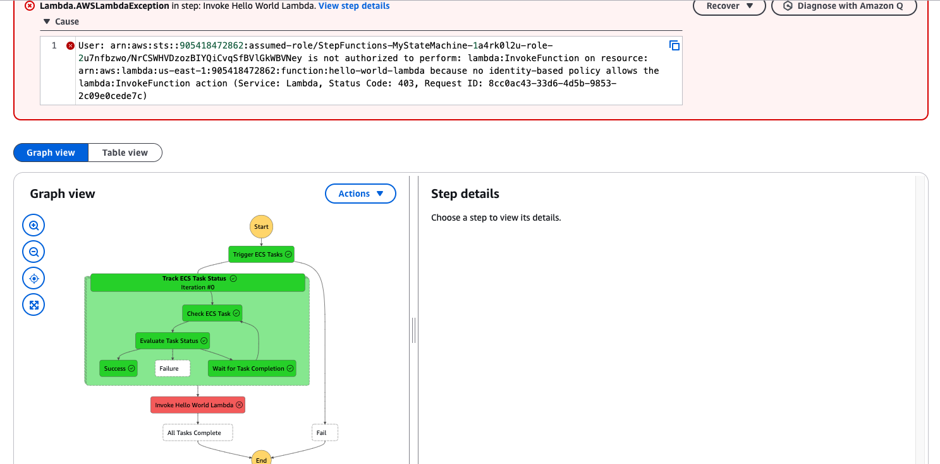

Slide 12
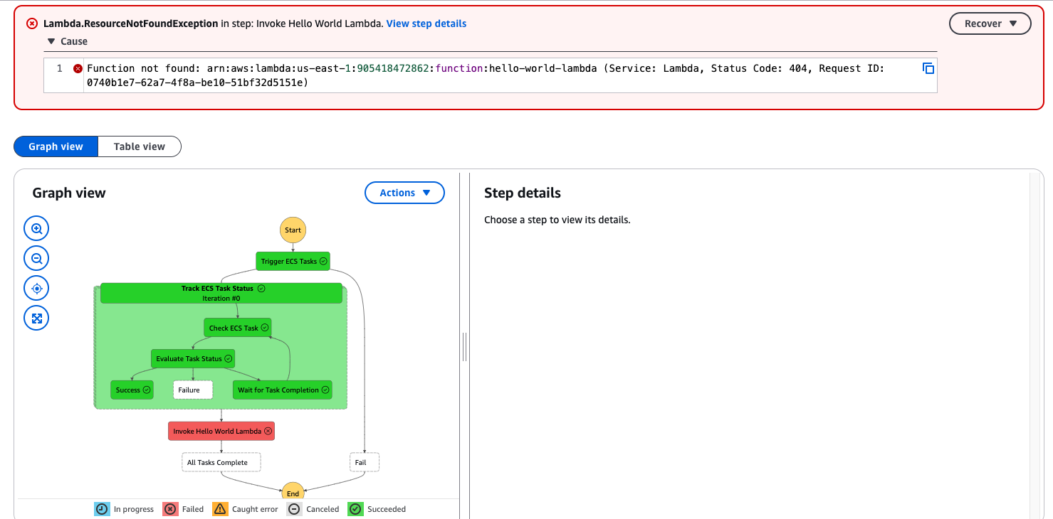

Slide 13
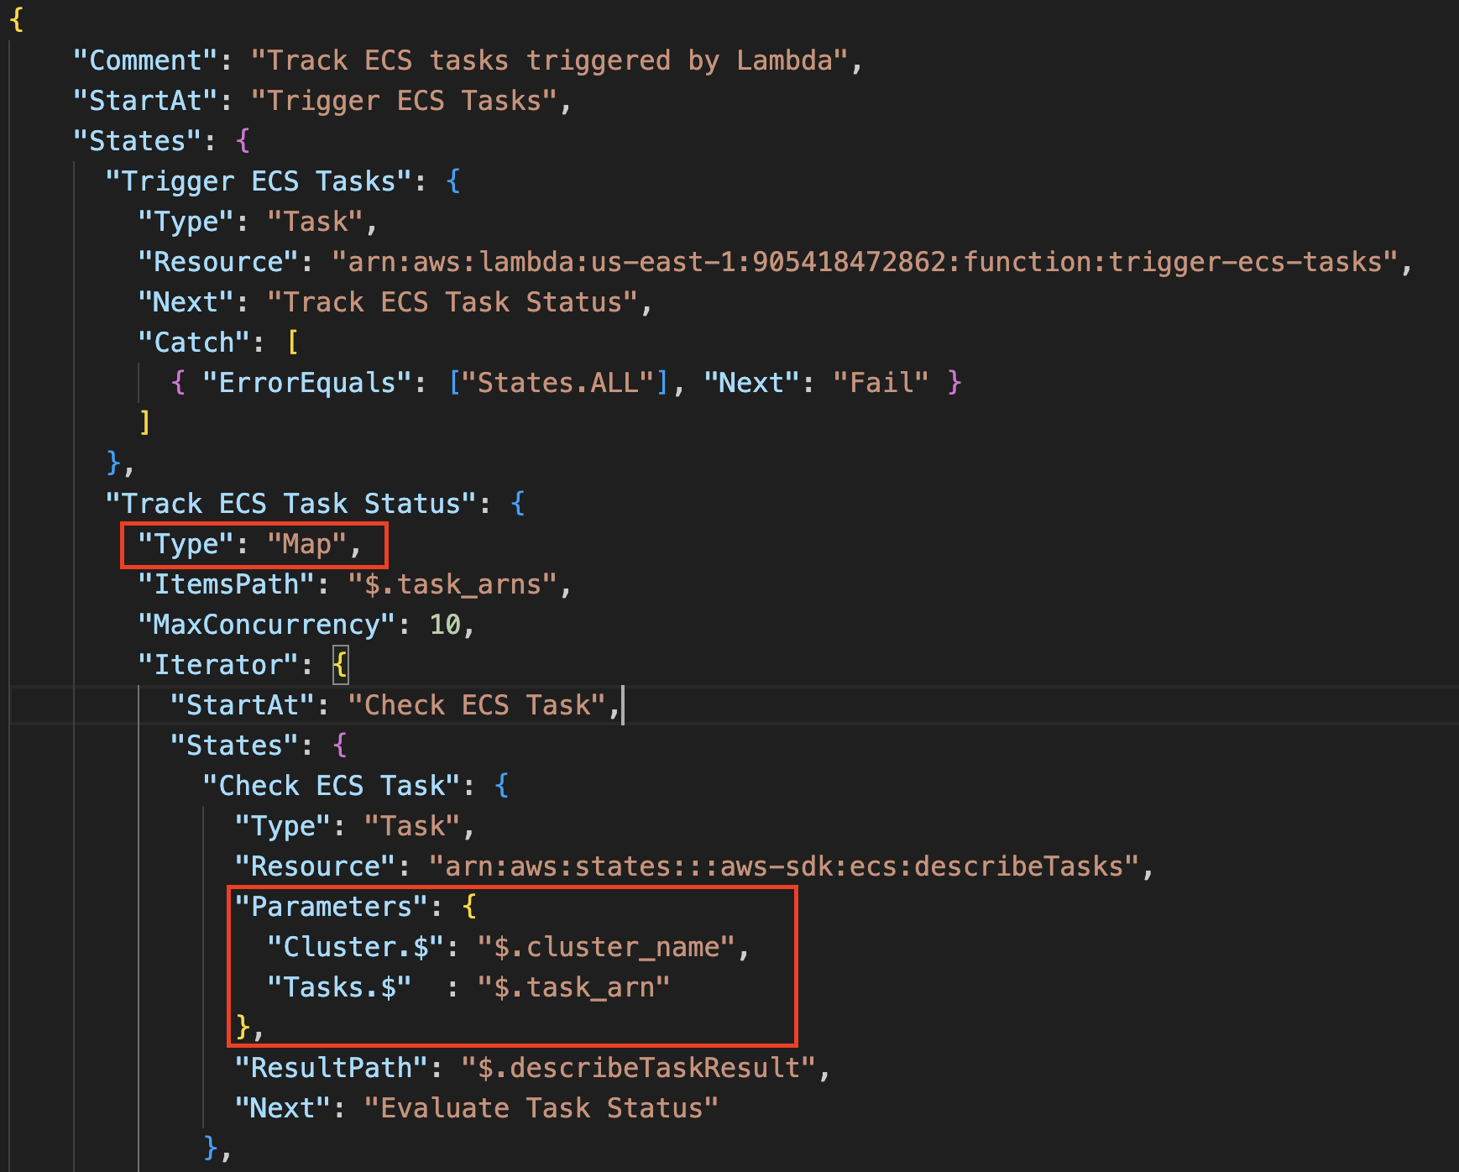
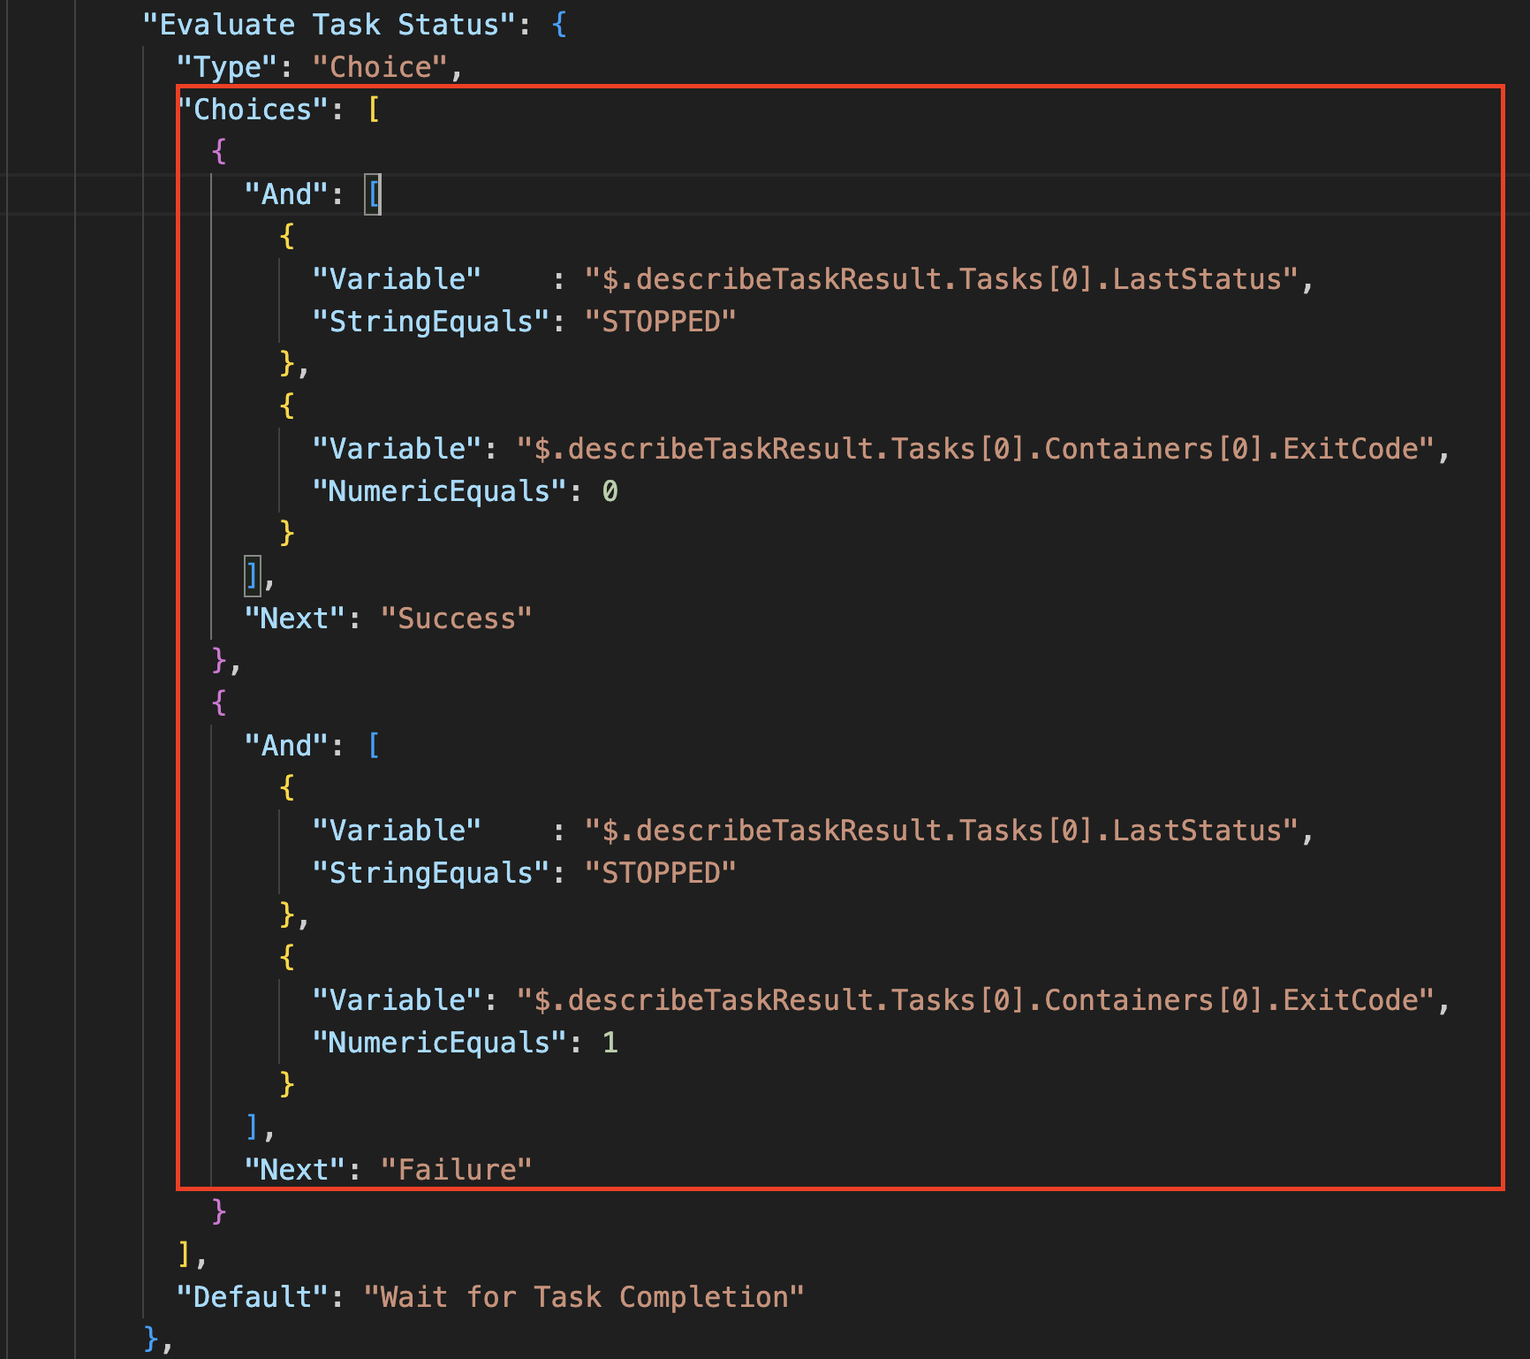

Slide 14
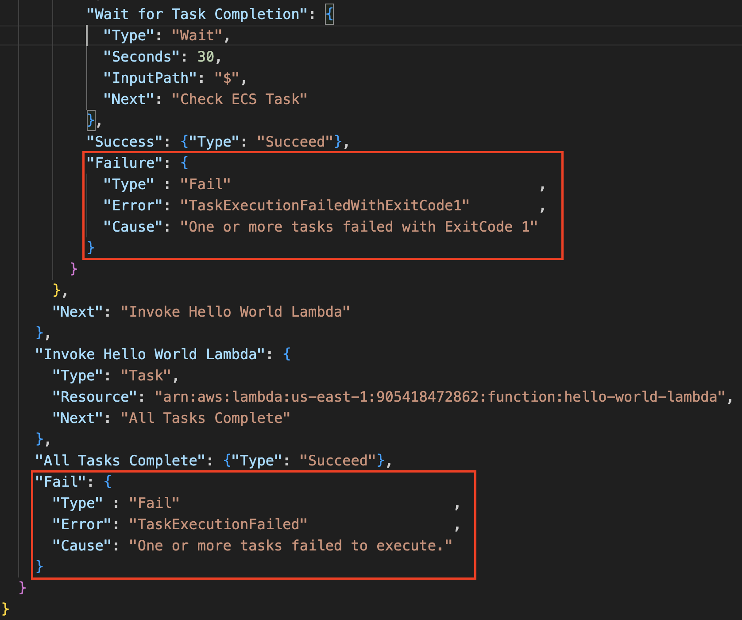

Slide 15
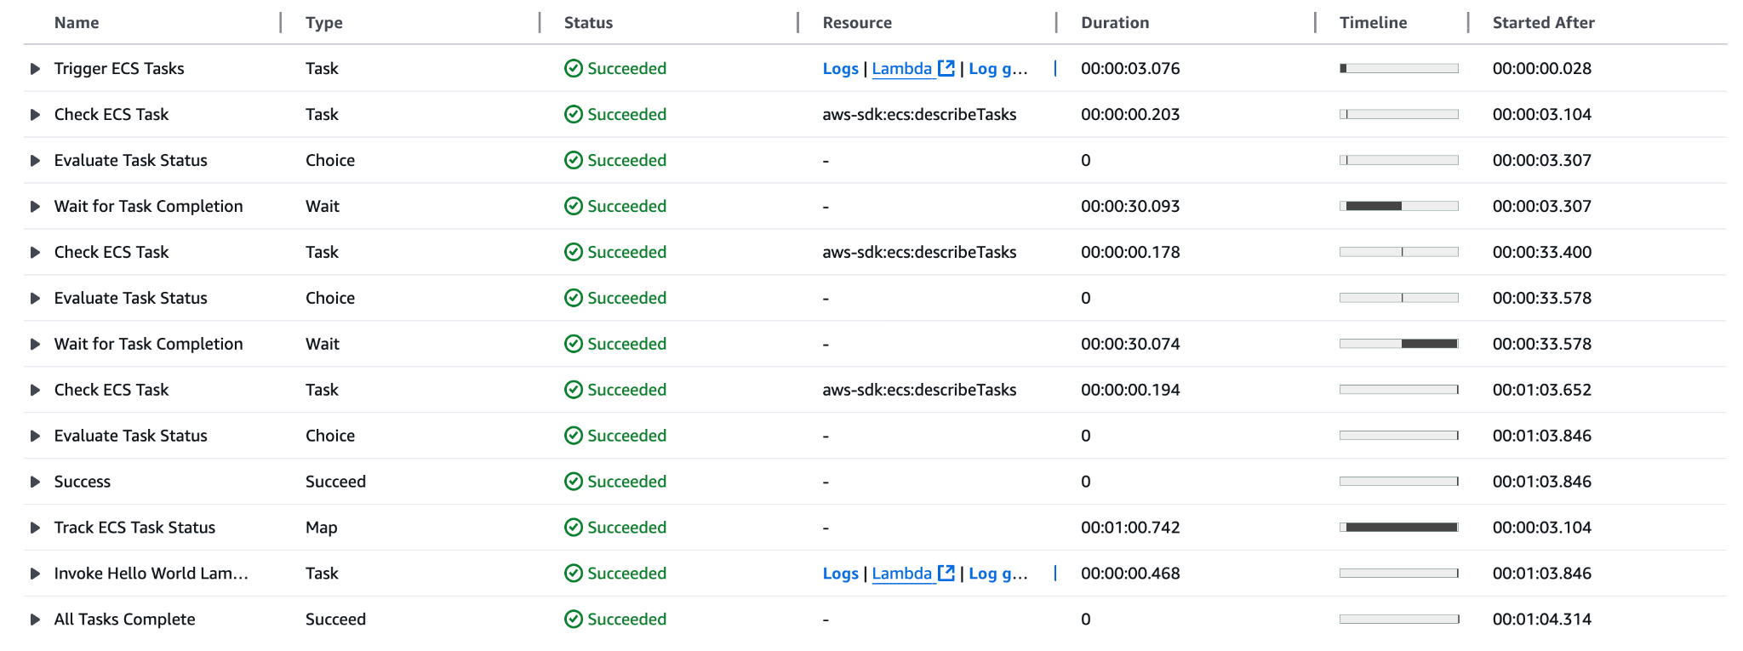

Slide 16
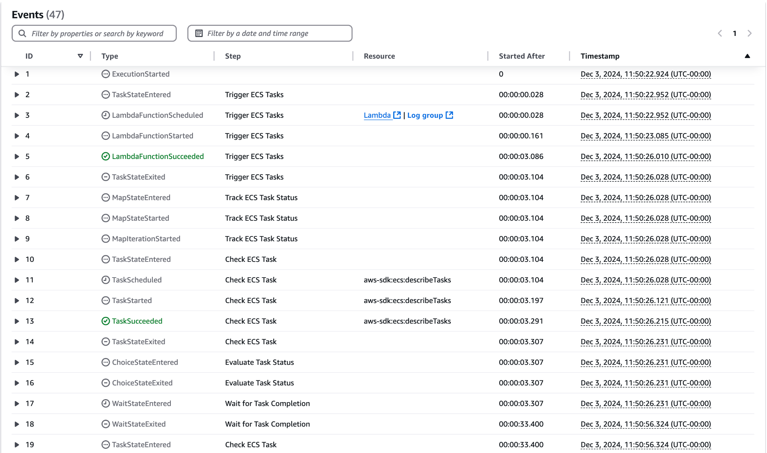

Slide 17
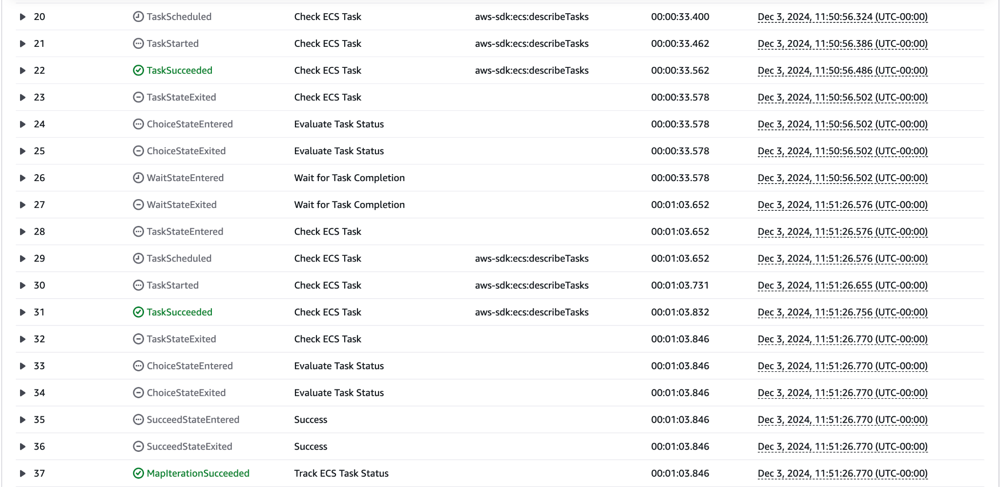

Slide 18
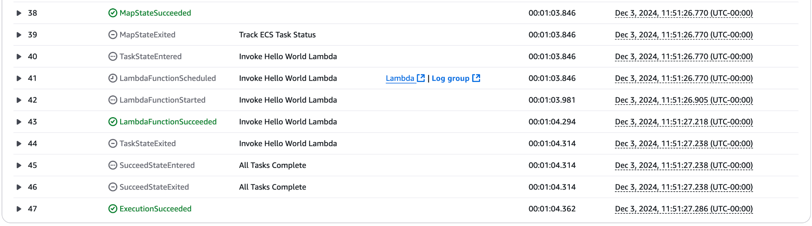

Slide 19
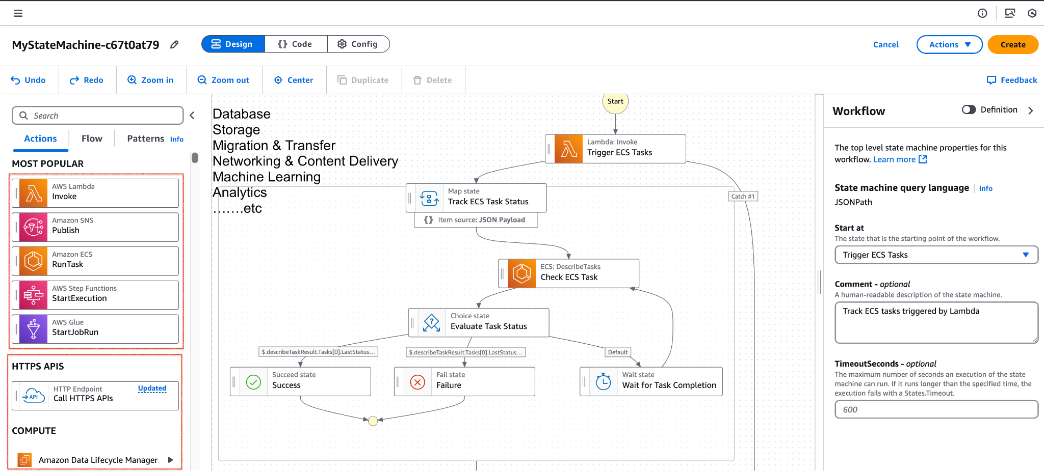

Slide 20
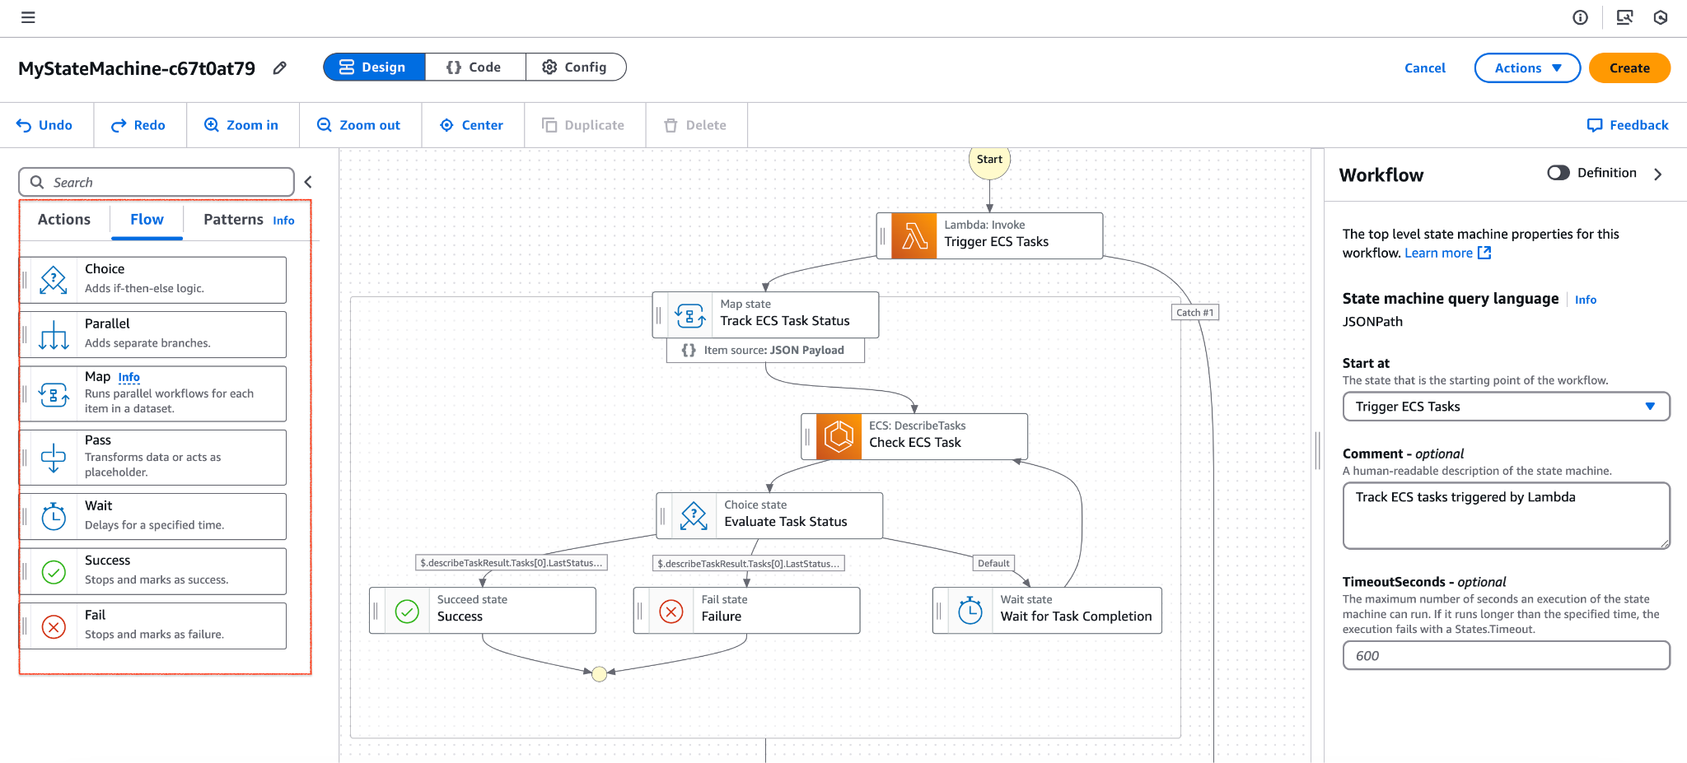

Slide 21
